Slide 1
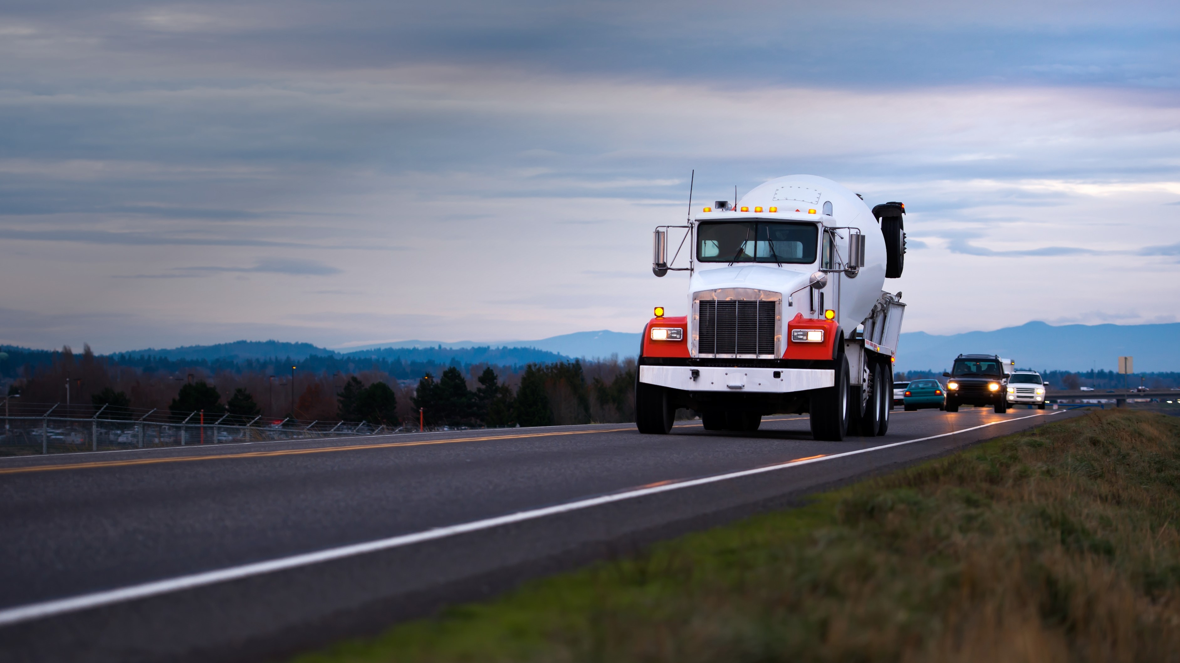
MIXOR Optimization Examples for Break Schedules
Privacy Notice: This document and its content is the absolute property of INFORM GmbH and/or its subcontractors. The reproduction, distribution and utilization of this document as well as the communication of its contents to others without express authorization is prohibited. Offenders will be held liable for the payment of damages. All rights reserved in the event of the grant of a patent, utility model or design.

Slide 2
Example 1: Break Proposal; Delivery ‘proposed’
 | Timescale
Truck | 10:00 | 06 | 10:30 | 08 | 11:00 | 10 | 11:30 | 12
Schedule
Prop 1
Prop 2
Example 2: Break Proposal; Delivery ‘assigned’
 | Timescale
Truck | 10:00 | 06 | 10:30 | 08 | 11:00 | 10 | 11:30 | 12
Schedule
Prop 1
Prop 2

Slide 3

Summary Baseline 1/2
The schedule must place
a break within the return run of the truck.
the return run directly behind the previous delivery
Notes:
Interaction between Logistics / Sales and Production => shared objectives focusing on the process (Its not about my customer, my plant or my trucks anymore)
Explain your Drivers why you are doing this and what it is you aim for. Train them

Slide 4
Summary Baseline 2/2
The schedule can place
a break ‘outside’ of a return run.
Technically it is not outside the return. The GUI only displays it that way.
 | Timescale
Truck | 10:00 | 06 | 10:30 | 08 | 11:00 | 10 | 11:30 | 12
Schedule
Prop 1
Prop 2
 | Timescale
Truck | 10:00 | 06 | 10:30 | 08 | 11:00 | 10 | 11:30 | 12
Schedule
Prop 1
Prop 2
Break Interval 10:30-11:30
Notes:
Interaction between Logistics / Sales and Production => shared objectives focusing on the process (Its not about my customer, my plant or my trucks anymore)
Explain your Drivers why you are doing this and what it is you aim for. Train them

Slide 5
Example 5: Update Schedules (independent of break type)
 | Timescale
Truck | 10:00 | 06 | 10:30 | 08 | 11:00 | 10 | 11:30 | 12
Schedule
Prop 1
Prop 2
Break Interval 10:30-11:30
 | Timescale
Truck | 10:00 | 06 | 10:30 | 08 | 11:00 | 10 | 11:30 | 12
Schedule
Prop 1
Prop
 | Timescale
Truck | 10:00 | 06 | 10:30 | 08 | 11:00 | 10 | 11:30 | 12
Schedule
Prop 1
Prop

Slide 6
Summary Update Schedules
 | Timescale
Truck | 10:00 | 06 | 10:30 | 08 | 11:00 | 10 | 11:30 | 12
Schedule
Prop 1
Prop 2
When update schedules moves a return run
the break must stay at the initial time inside the return run if break start > now
the break must not stay at the initial time inside the return run if break start = now
When the break does not fit into the return run until the end of the break interval anymore
it must not be planned anymore
Notes:
Interaction between Logistics / Sales and Production => shared objectives focusing on the process (Its not about my customer, my plant or my trucks anymore)
Explain your Drivers why you are doing this and what it is you aim for. Train them

Slide 7
Example 6: Break Transaction; ‘Automatic Return Run’; Break timestamps within Return Run
 | Timescale
Truck | 10:00 | 06 | 10:30 | 08 | 11:00 | 10 | 11:30 | 12
Schedule
Prop 1
Prop 2
Example 7: Break Transaction; ‘Automatic Return Run’; Break timestamps behind/(at the end of) Return Run
 | Timescale
Truck | 10:00 | 06 | 10:30 | 08 | 11:00 | 10 | 11:30 | 12
Schedule
Prop 1
Prop 2

Slide 8

Example 8: Break Transaction; ‘Assign Best’;
 | Timescale
Truck | 10:00 | 06 | 10:30 | 08 | 11:00 | 10 | 11:30 | 12
Schedule
Prop 1
Prop 2
 | Timescale
Truck | 10:00 | 06 | 10:30 | 08 | 11:00 | 10 | 11:30 | 12
Schedule
Prop 1
Prop 2

Slide 9
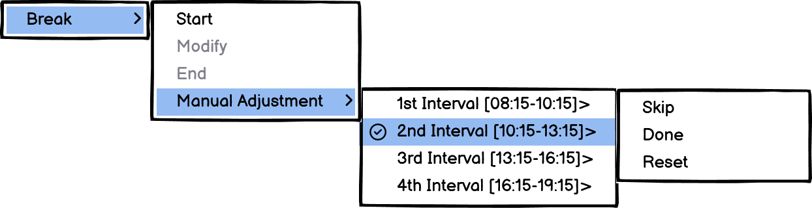
Example 10: User Skips Break
 | Timescale
Truck | 10:00 | 06 | 10:30 | 08 | 11:00 | 10 | 11:30 | 12
Schedule
Prop 1
Prop 2
Break Interval 10:30-11:30
 | Timescale
Truck | 10:00 | 06 | 10:30 | 08 | 11:00 | 10 | 11:30 | 12
Schedule
Prop 1
Prop 2
When the user manually sets a break to skip or done for a certain interval, the optimization must not plan it anymore.

Slide 10
Example 11: Manual Break Start
 | Timescale
Truck | 10:00 | 06 | 10:30 | 08 | 11:00 | 10 | 11:30 | 12
Schedule
Prop 1
Prop 2
Prop 3
Break Interval 10:00-11:30
To be discussed again
 | Timescale
Truck | 10:00 | 06 | 10:30 | 08 | 11:00 | 10 | 11:30 | 12
Schedule
Prop 1
Prop 2
Prop 3
Break Interval 10:00-11:30
When a user manually assigns a break, the server must remove the planned break from the schedule

Slide 11
No Manual break planning
The user will not be able to:
Manually plan a break with a certain proposal
Manually plan a break at a certain time
 | Timescale
Truck | 10:00 | 06 | 10:30 | 08 | 11:00 | 10 | 11:30 | 12
Schedule
Prop 1
Break Interval 10:30-11:30
 | Timescale
Truck | 10:00 | 06 | 10:30 | 08 | 11:00 | 10 | 11:30 | 12
Schedule
Prop 1
Prop 2
Break Interval 10:30-11:30
Notes:
Interaction between Logistics / Sales and Production => shared objectives focusing on the process (Its not about my customer, my plant or my trucks anymore)
Explain your Drivers why you are doing this and what it is you aim for. Train them

